Slide 1
Basic Concepts of Image Processing
By-
Abhinaba Chowdhury
Abhiroop Mukherjee
Debarghya Dey
Jyotiprakash Roy
Shrutanten

Slide 2
1.) What is Digital Image Processing?
Digital image processing is the use of a digital computer to process digital images through an algorithm.
It allows a much wider range of algorithms to be applied to the input data and can avoid problems such as the build-up of noise and distortion during processing.
Image processing is a method to perform some operations on an image, to get an enhanced image or to extract some useful information from it.

Slide 3
2.) Why do we need digital image processing?
Some of the uses of digital image processing are:
Computer Vision - Computer vision is a kind of automated watchdog, which uses both science and technology. Being a discipline from science, computer vision is related to theory for design of artificial systems that can acquire information from images.
Face Detection - In this method important facial features are detected and else are ignored. Face detection can be treated as a specific case of object class detection. The objective of face detection is to find the specified features such locations and sizes of a known number of faces.
Biometric Verification - It refers to the automatic identification or recognition of humans by their behaviors or characteristics.

Slide 4
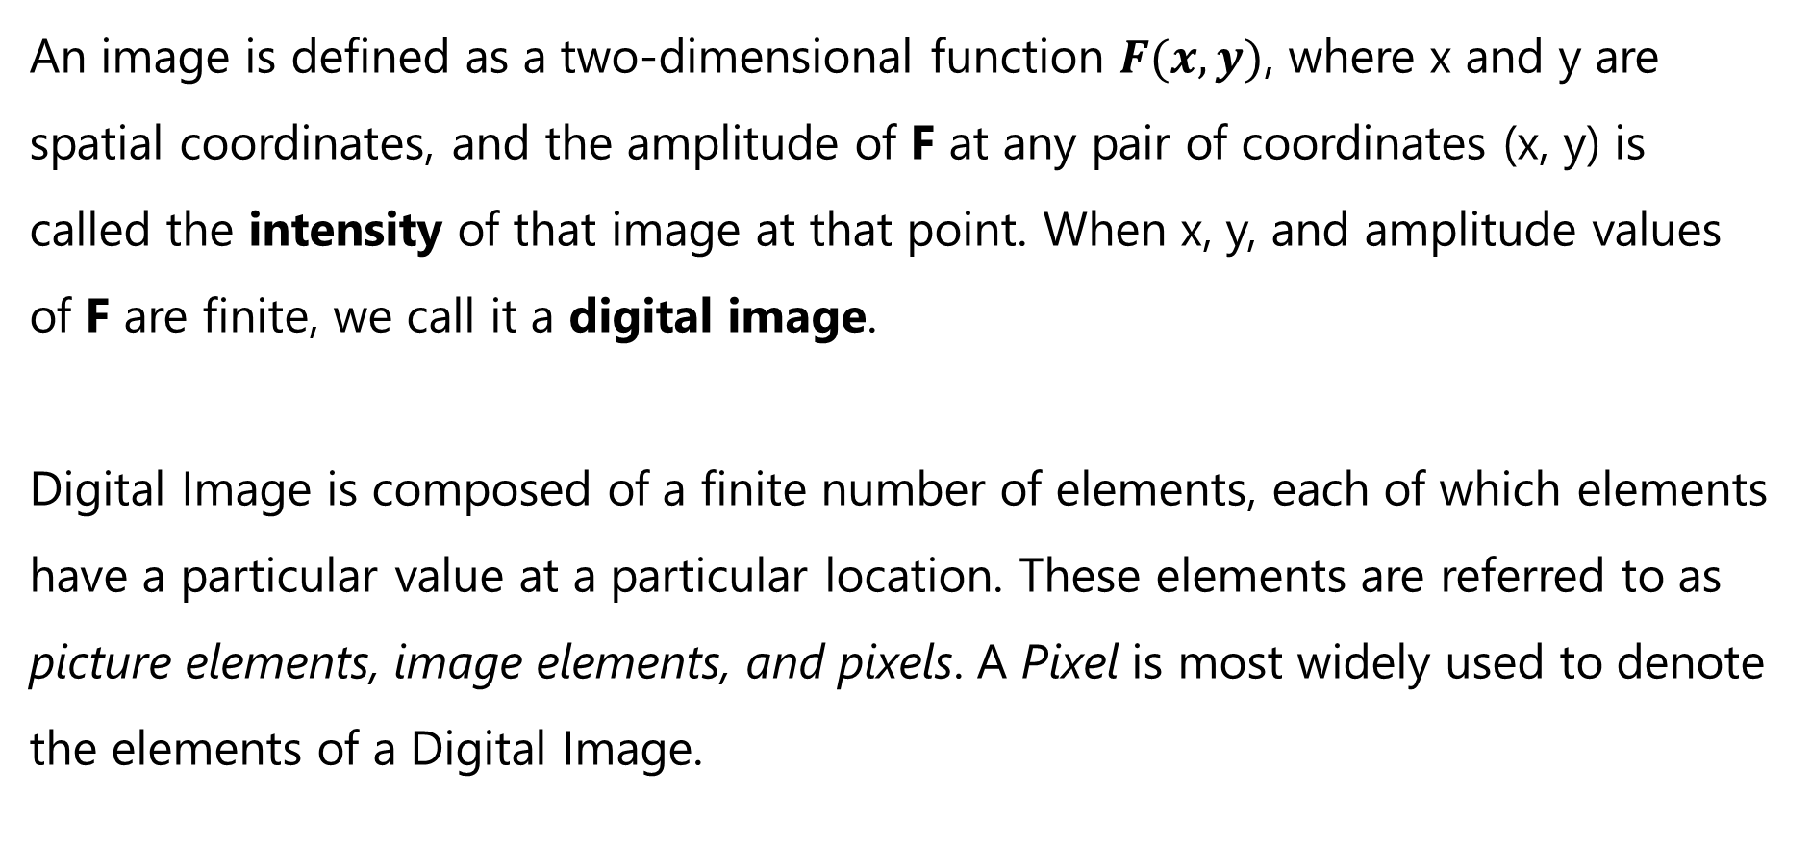
3.) Representing Digital Images
An image is defined as a two-dimensional function $F(x, y)$, where x and y are spatial coordinates, and the amplitude of F at any pair of coordinates (x, y) is called the intensity of that image at that point. When x, y, and amplitude values of F are finite, we call it a digital image.
Digital Image is composed of a finite number of elements, each of which elements have a particular value at a particular location. These elements are referred to as picture elements, image elements, and pixels. A Pixel is most widely used to denote the elements of a Digital Image.

Slide 5
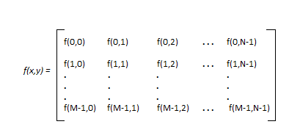
3.) Representing Digital Images (continued)
Images are represented in rows and columns. We have the following example in which images are represented:
The right side of this equation is Digital Image by definition. Every element of this matrix is called an image element, picture element, or pixel.

Slide 6
4.) Different Image Types and File Formats
Some image file formats are:
JPEG
PNG
GIF
Exif
TIFF
BMP
PPM, PGM, PBM, and PNM
WebP
BAT

Slide 7
4.) Different Image Types and File Formats (continued)
Types of an image
BINARY IMAGE– The binary image as its name suggests, contain only two pixel elements ,i.e., 0 & 1,where 0 refers to black and 1 refers to white. This image is also known as Monochrome.
BLACK AND WHITE IMAGE– The image which consist of only black and white color is called BLACK AND WHITE IMAGE.
8 bit COLOR FORMAT– It is the most famous image format. It has 256 different shades of colors in it and commonly known as Grayscale Image. In this format, 0 stands for Black, and 255 stands for white, and 127 stands for gray.
16 bit COLOR FORMAT– It is a color image format. It has 65,536 different colors in it. It is also known as High Color Format. In this format the distribution of color is not as same as Grayscale image. A 16 bit format is actually divided into three further formats which are Red, Green and Blue. That famous RGB format.

Slide 8
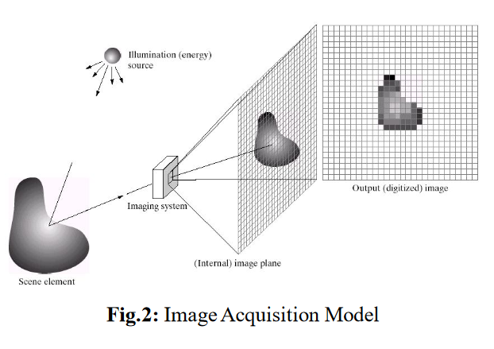
5.) Image Acquisition Technique, an Overview

Slide 9
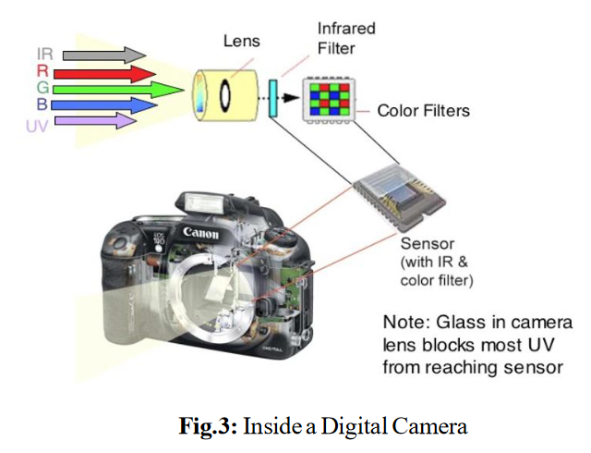
5.) Image Acquisition Technique, an Overview (continued)

Slide 10
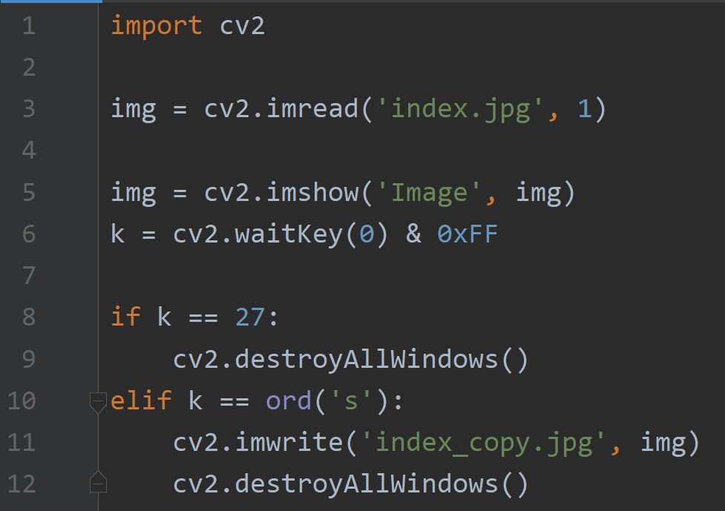
Ex.) Python Code to Read, Show and Save an Image

Slide 11
Ex.) Python Code to Read, Show and Save an Image (continued)
1. As a first step, we read the image “index.jpg". In order to do so, a call to the imread() function loads the image using the file path specified by the first argument. The second argument is optional and specifies the format in which we want the image. This may be:
IMREAD_GRAYSCALE (0) loads the image as an intensity one.
IMREAD_COLOR (1) loads the image in the BGR 8-bit format. This is the default that is used here.
2. After reading, the image data will be stored in the img variable.
3. Then, the image is shown using a call to the imshow() function. The first argument is the title of the window and the second argument is the variable that stores the image that will be shown.
4. Because we want our window to be displayed until the user presses a key, we use the waitKey() function whose only parameter is just how long should it wait for a user input (measured in milliseconds). Zero means to wait forever. The return value is the key that was pressed.
5. In the end, the image is written to a file if the pressed key was the “S”-key. For this, the imwrite() function is called that has the file path and the image variable as an argument.

